Slide 1
The Process of Completing an eDMR

Slide 2
The Process of completing an eDMR
There are two different websites: one to fill in the eDMR (E2) and one to sign the eDMR (ERS).
E2 address: https://applications.deq.ok.gov/E2
ERS address: https://applications.deq.ok.gov/ERS

Slide 3
THE PROCESS
E2
ERS
DMR not approved
ODEQ
DMR approved
NMS

Slide 4
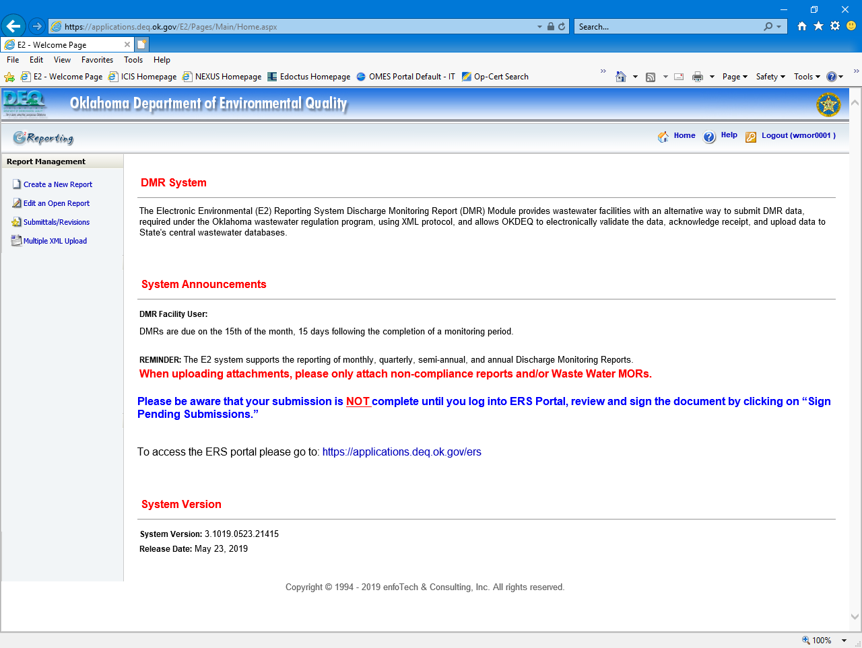
E2: Home Page after Login

Slide 5
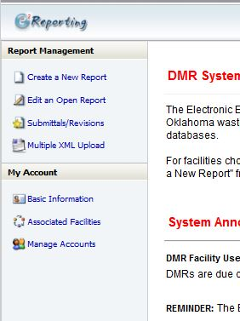
E2: Home Page after Login
Click here to begin the eDMR process

Slide 6
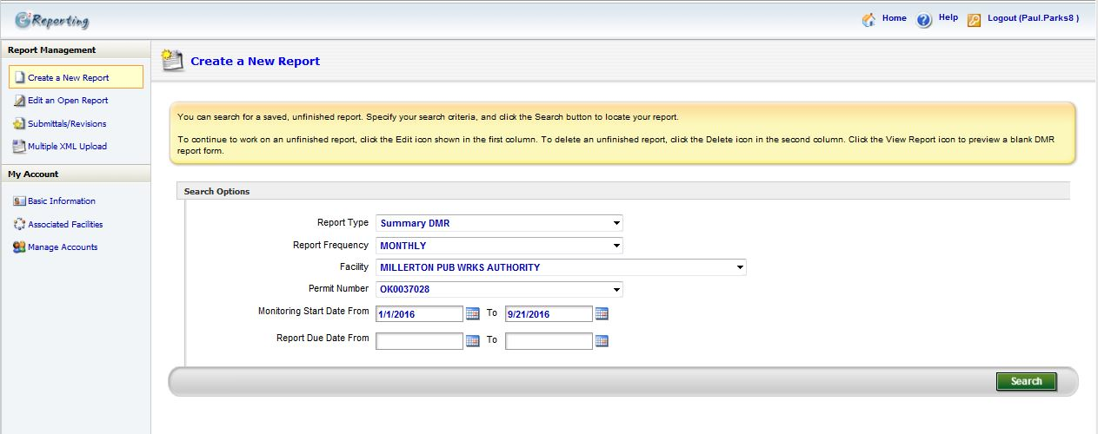
E2: Preparer Create eDMR
Enter Facility Information Here
Click here to Search by the given criteria
Enter Monitoring Start and End dates here
Remove any information in these fields

Slide 7
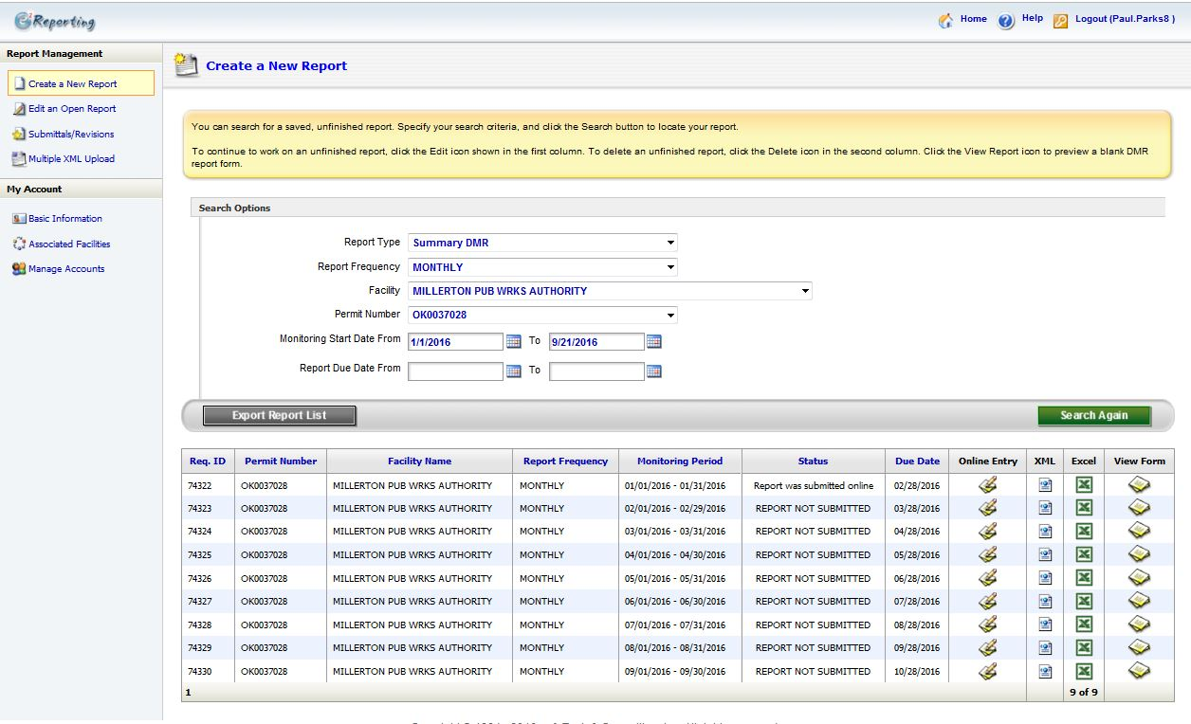
E2: Preparer Create eDMR
Click one of these icons to open that particular eDMR that you would like to create
List of eDMRs found within your search criteria

Slide 8
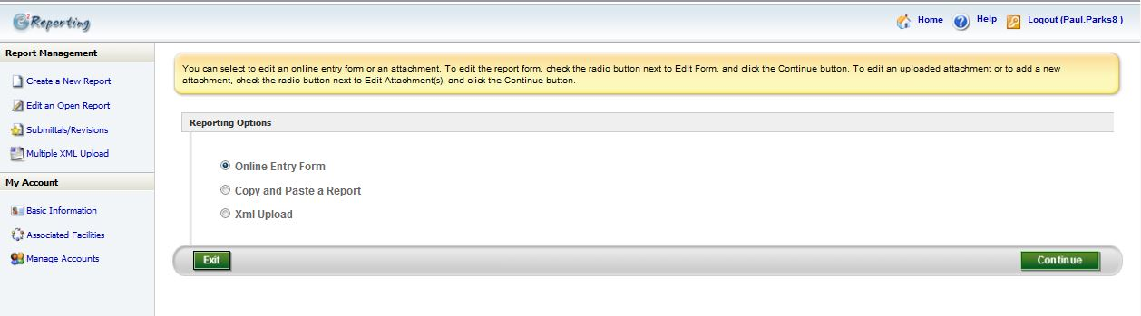
E2: Preparer Create eDMR
Select “Online Entry Form”
Click “Continue”

Slide 9
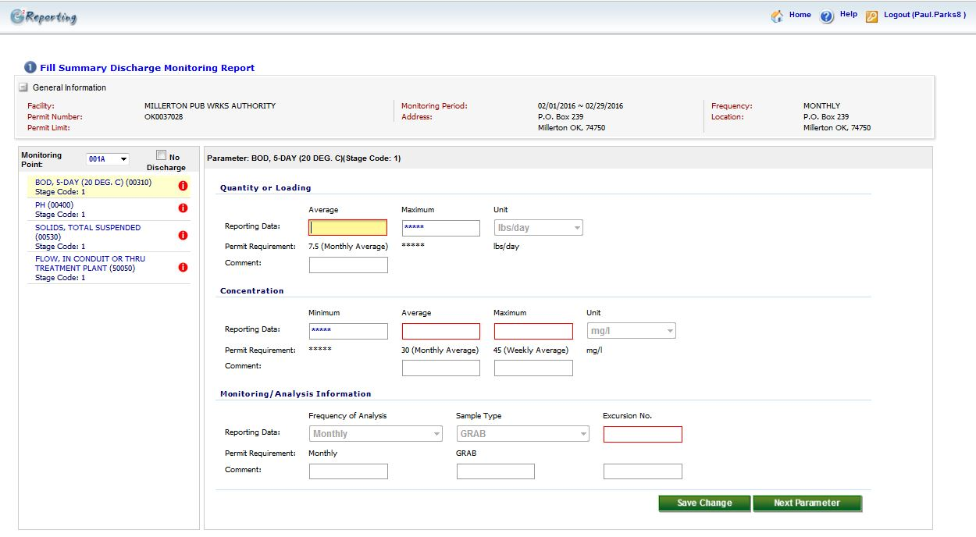
E2: Preparer Create eDMR
Enter the values for Loading here
Click through each Parameter
After filling in all the boxes click “Save Changes” and then “Next Parameter”
Enter the values for concentrations here
Enter the number of exceedances here

Slide 10
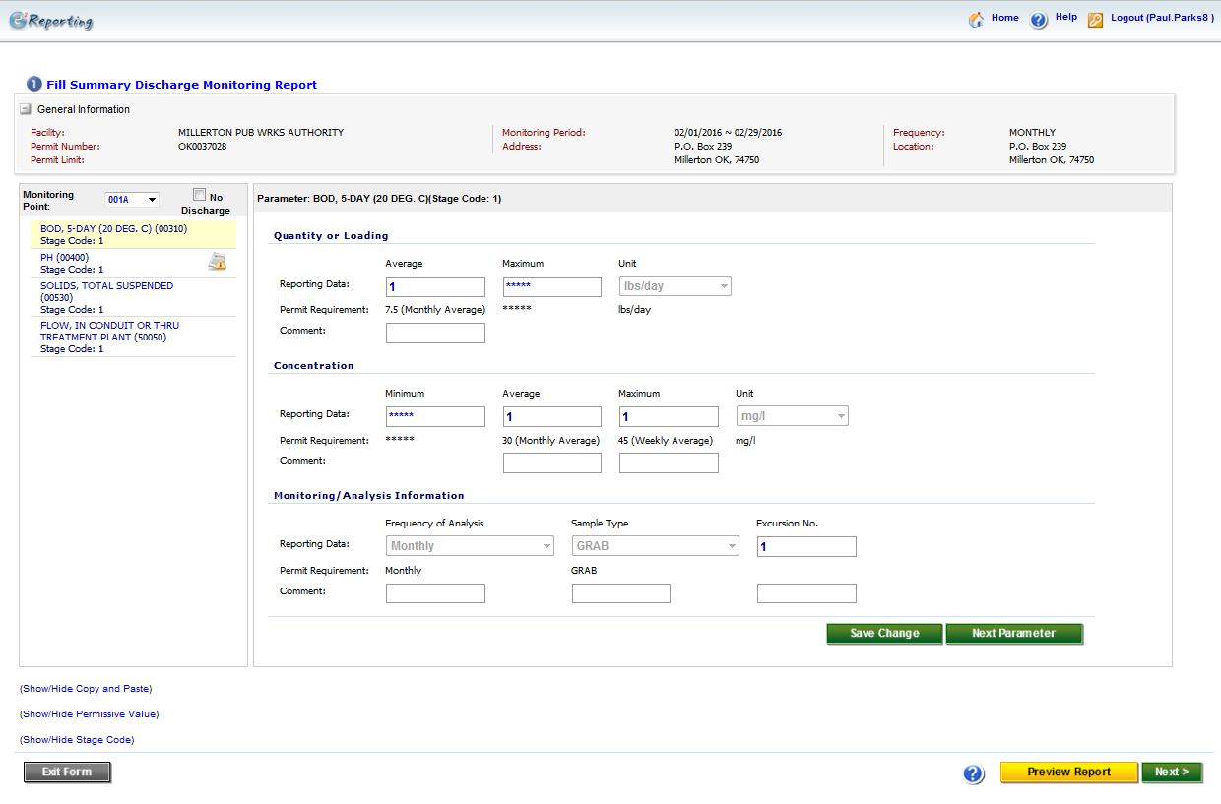
E2: Preparer Create eDMR
Notice that the red action symbols are gone. This means that all the values needed have been entered.
If everything looks correct, click Next
Click here to preview what the eDMR will look like

Slide 11
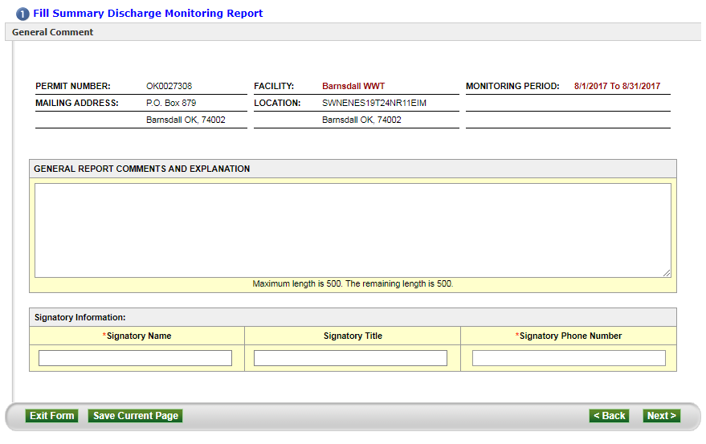
E2: Preparer Create eDMR
Use this field to add any comments you may want (Optional)
Enter the Signatory’s name
Click Next
Enter the Signatory’s phone number

Slide 12
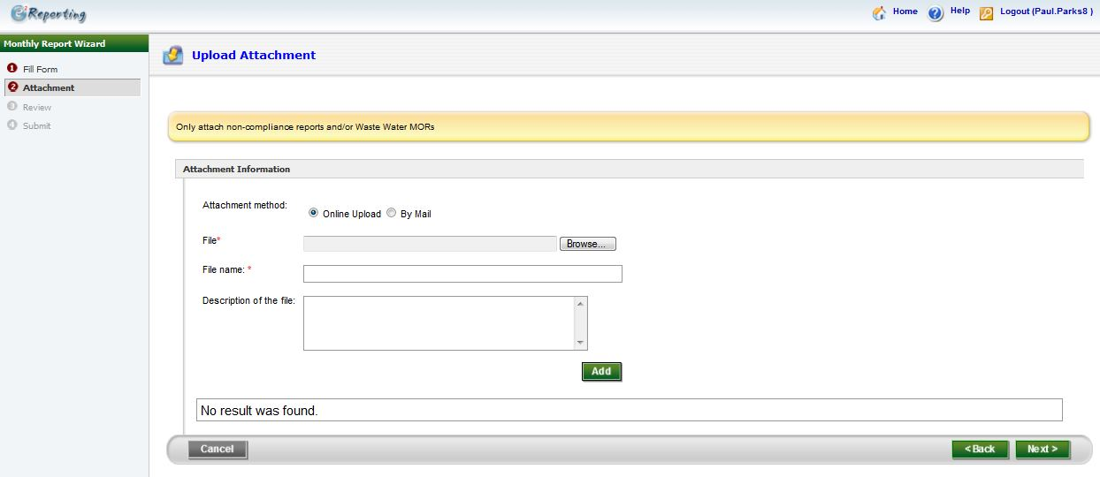
E2: Preparer Create eDMR
This page is optional. If you have a “Non-Compliance Report” and/or “Waste Water MORs” you can use this page to attach it to your eDMR submission
Click Next

Slide 13
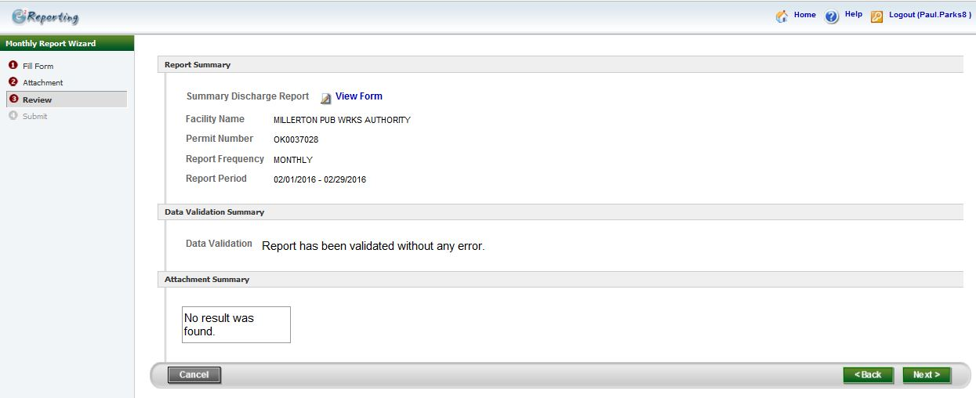
E2: Preparer Create eDMR
Click here to view a copy of the eDMR you will be submitting
Click Next

Slide 14
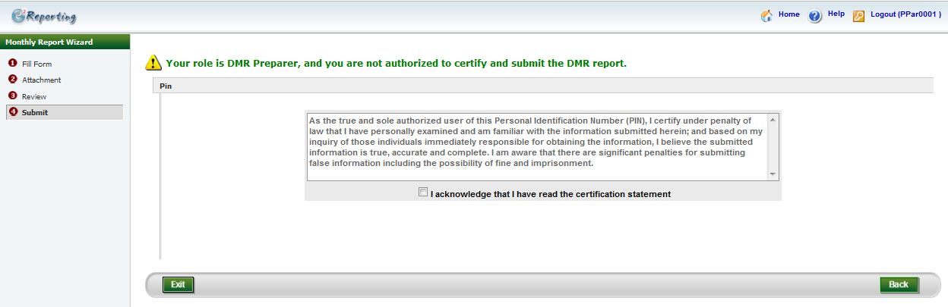
E2: Preparer Create eDMR
As Preparer you cannot submit the eDMR.
Clicking “Exit” will save the eDMR. Once you have done this, notify the Signatory that the eDMR is ready for review and submittal. Your part is done.

Slide 15
Different types of eDMRs to fill out
Monthly eDMRs
Biomonitoring or Toxicity eDMRs are usually quarterly unless the permit says otherwise
Upstream or downstream eDMRs are usually monthly
Priority pollutant eDMRs
Sludge eDMRs are annual and are due on February 19th of the following calendar year

Slide 16
If you have no discharge do you still have to send in the eDMR?
YES

Slide 17
How to start to figure the calculations for the eDMR
Monthly average – also referred to as “average monthly,” this is the arithmetic mean of all results over a calendar month for a specific pollutant.
Weekly average – also referred to as “average weekly,” this is the arithmetic mean of all results over a calendar week, from Sunday through Saturday, for a specific pollutant.
We recognize that calendar weeks and calendar months rarely coincide. For the purpose of calculating and reporting 7-day averages you should follow this process: If you are a weekly tester, you need to define your week and stick with it
Sunday- Saturday or Monday-Sunday etc.
Months do not always begin on a Sunday and end on a Saturday – how should weekly average values account for this?
Weekly average values are based on a calendar week of Sunday to Saturday. The first week of the month, for reporting purposes, always begins on a Sunday, and the last week of the month always ends on a Saturday. When a week is split between two months, the weekly average value for that week will be reported with the month containing the most days of that week.

Slide 18
Example
Example – April 2009. April 1st is a Wednesday. The first week of April would include, for the purpose of calculating weekly averages, Sunday, March 29th , Monday, March 30th and Tuesday, March 31st . April 30th is a Thursday. The last week of April would include Friday, May 1st and Saturday, May 2nd . Therefore, five weeks would be considered for April 2009: March 29th – April 4th (Week 1), April 5th – 11th (Week 2), April 12th – 18th (Week 3), April 19th – 25th (Week 4) and April 26th – May 2nd (Week 5).

Slide 19
Monthly Average Calculation
How is the monthly average calculated for reporting on DMRs?
A monthly average is calculated by the sum of all daily discharges measured during a calendar month divided by the number of daily discharges measured during the month. All samples collected during the month must be included in the calculation.

Slide 20
What to do with an Invalid test
An invalid test is defined as any test which does not satisfy the test acceptable criteria, procedures , and quality assurance requirements specified in the test methods and permit.
Should we use these results in calculations for the eDMR?
NO! Because they didn’t pass QC. Report the value and the date of the sample in the comments section of the eDMR. Do not include the value(s) in monthly loading or concentration calculations.

Slide 21
What do we do with test results that are below detectable limits?
Unless otherwise stated in the permit, values below the detection limit are to be reported with a less than symbol ( < ) and the numeric value for the detection limit using the EPA approved method.
Where the permit contains a listing of Minimum Quantification Levels (MQLs) and the permittee is granted authority in the permit to report zero in lieu of the <MQL for a specified parameter, (conventional, priority pollutants, metals, etc.) then zero is to be reported for that parameter.
In some cases the permittee has been granted by letter the authority to report zero when the permit does not contain this language. The permittee may request this authorization from its regulatory agency.

Slide 22
Below detectable limit examples
MQL of BOD is 2.0
Week 1: BOD <2.0
Week 2: BOD 10
Week 3: BOD <2.0
Week 4: BOD 5
How do you report BOD loading and concentration?
BOD loading BOD monthly weekly avg BOD maximum weekly
<8.6 <4.75 10

Slide 23
Below detectable limit examples continued
BPQL of BOD is 2.0
Week 1: BOD <2.0
Week 2: BOD <2.0
Week 3: BOD <2.0
Week 4: BOD <2.0
How do you report BOD loading and concentration?
BOD loading BOD monthly weekly avg BOD maximum weekly
<8.6 <2.0 <2.0

Slide 24
How do we report exceedances?
Number of Exceedance - Total of sample measurements that exceed the daily maximum, daily minimum, or 7-day maximum (weekly) average permit limit. DO NOT include monthly average or daily average violations in this field or Flow. If none, enter “0". Permittees with continuous pH, or temperature monitoring requirements should consult the permit for what constitutes an exceedance and report accordingly.
On the eDMR, it is shown as NO. EX……this is not how many times you sampled. That column is the FREQUENCY OF ANALYSIS.

Slide 25
Examples
How many exceedances for e coli does this facility have?
Permit limits: Geometric mean 126 Daily maximum 406
Sample 1 56
Sample 2 500
Sample 3 400
Sample 4 20000
Sample 5 126
Sample 6 60000
Sample 7 405
Sample 8 1000
Geometric mean = 954 Daily maximum = 60000
Answer: 4

Slide 26
Examples
How many exceedances for BOD5 does this facility have?
Permit limits: Loading Monthly Average 6.6
Weekly Monthly Average 30
Maximum 7-Day Weekly Avg 45
Week 1 31 Loading results 6.7
Week 2 35 Loading results 8.0
Week 3 47 Loading results 8.5
Week 4 34 Loading results 7.7
Answer: 1 Why? Week 3 was the only one that exceeded the maximum weekly limit. Exceedances are only for maximum or minimum limits. Not monthly limits.

Slide 27
How do I round numbers and ratios?
Permits sometimes require the rounding of numbers or ratios. These numbers or ratios
should be rounded as follows:
1) If the digit 6, 7, 8, or 9 is dropped, increase preceding digit by one unit. Example: a calculated parameter of 1.06 should be rounded to 1.1 and reported as a violation of the permit limit if the permit limit is 1.0.
2) If the digit 0, 1, 2, 3, or 4 is dropped, do not alter the preceding digit. Example: a calculated parameter of 1.04 should be rounded to 1.0 and reported to EPA as compliant with the permit limit if the permit limit is 1.0.
3) If the digit 5 is dropped, round off preceding digit to the nearest even number. Example: a calculated ratio of 1.05 should be rounded to 1.0 and reported to EPA as compliant with the permit limit if the permit limit is 1.0
4) If BOD limit is 30.0, report it to the tenth. Example: BOD monthly average was 29.54. It should be reported as 29.5. If the BOD is 29.56, the reportable BOD should be 29.6.

Slide 28
Examples of how to round numbers
Example 1: BOD sample = 20.51 = 20.5
Example 2: BOD sample = 20.56 = 20.6
Example 3: Flow = 0.4414 = 0.441
Example 4: Flow = 0.4415 = 0.441
Example 5: Flow = 0.4418 = 0.442
Question 1: Flow = 0.9989 = ???????
Question 2: Flow = 0.2056 = ???????

Slide 29
How do we calculate monthly flow results?
If daily flow is required and the facility discharged all 30 days then the monthly average equals total flow for the month divided by number of days of discharge:
Total flow =15.4 million gallons per day (MGD)
30 days of discharging
Monthly Average Flow = 15.4 MGD / 30 days = 0.513 MGD

Slide 30
How do we calculate monthly flow results?
If daily flow is required but the facility discharged only 15 days, the monthly average flow is:
Total flow =10 MGD
15 days of discharging
Monthly Average Flow = 10 MGD / 15 days = 0.666 MGD

Slide 31
How to report flow results?
Not all facilities report in million gallons (Industrial facilities). CHECK YOUR PERMIT
Flow should be reported with at least one significant digit. So no 0.00085 on flow. It should be 0.0008
Major facilities and most minor facilities don’t report past the thousandth. Example :
Flow is 1.2346 Report on the eDMR should be 1.235
Flow is 0.9894 Report on the eDMR should be 0.989
Flow is 0.00095 Report on the eDMR should be 0.0009

Slide 32
Example
If flow is only required 2 per week, then monthly average flow is:
        Day 1 Day 2
Week 1 flow: 0.56 MGD 0.60 MGD
Week 2 flow: 0.45 0.55
Week 3 flow: 0.86 0.77
Week 4 flow: 0.57 0.60
Total flow = 0.56 + 0.60 + 0.45 + 0.55 + 0.86 + 0.77 + 0.57 + 0.60 = 4.96/8 =0.62 MGD
Daily Maximum Flow = 0.86

Slide 33
How do we calculate loadings?
Not every permit requires the same. The flow can be in gallons per day or million gallons per day
How is the average mass load calculated in terms of pounds (lbs) per day?
Calculate the daily load in lbs/day by multiplying the average concentration of the parameter (in mg/l) on one day by the average flow (in million gallons per day) on the same day and a conversion factor of 8.34. Then sum the daily loads during the reporting period (e.g., month) and divide by the number of daily loads in that period (number of samples). For calculating an average weekly load, sum the measured daily loads during the week (Sunday – Saturday) and divide by the number of daily loads for the week.
Sample result X 8.34 X Flow of the day the sample was taken in million gallons per Day
Testing 2 per month: Sample 1 20 X 8.34 X 1.2= 200.16 round the number =200.2
Sample 2 25 X 8.34 X 1.1=229.35 round the number =229.3 Answer: 200.2+229.3/2=214.7

Slide 34
How do we calculate geometric mean?
For samples that have a value of TNTC on a plate count, the value must be 60000 / 100 mL for calculating the geometric mean. Never put “TNTC” for the geometric mean
For samples that have a value of “0 colonies” on a plate count, the value must be 1 / 100 mL for calculating the geometric mean. Never put “0” for the geometric mean
In order to calculate geometric mean we use 2 formulas
Method 1: Geometric Mean = “nth” root of n1 x n2 x n3 Example: 1 X 150 =150 of 2nd root = 12.2
Method 2: is the average sum of the logs (log n1 + log n2...) followed by the anti-log of the average Example: log 1 + log 150 = 0 + 2.176 = 2.176 / 2 = 1.088 = inv log 1. 088 = 12.2

Slide 35
Examples of calculating the geometric mean
Sample 1: TNTC
Sample 2: 300
Sample 3: 150
Sample 4: BPQL
Method 1: 60000 x 300 x 150 x 1= 2,700,000,000 ^ 1/4 = 227.9
Method 2: log 60000 + log 300 + log 150 + log 1= 4.77 + 2.47 + 2.17 + 0= 9.41
Inv. Log 9.41= 227.9

Slide 36
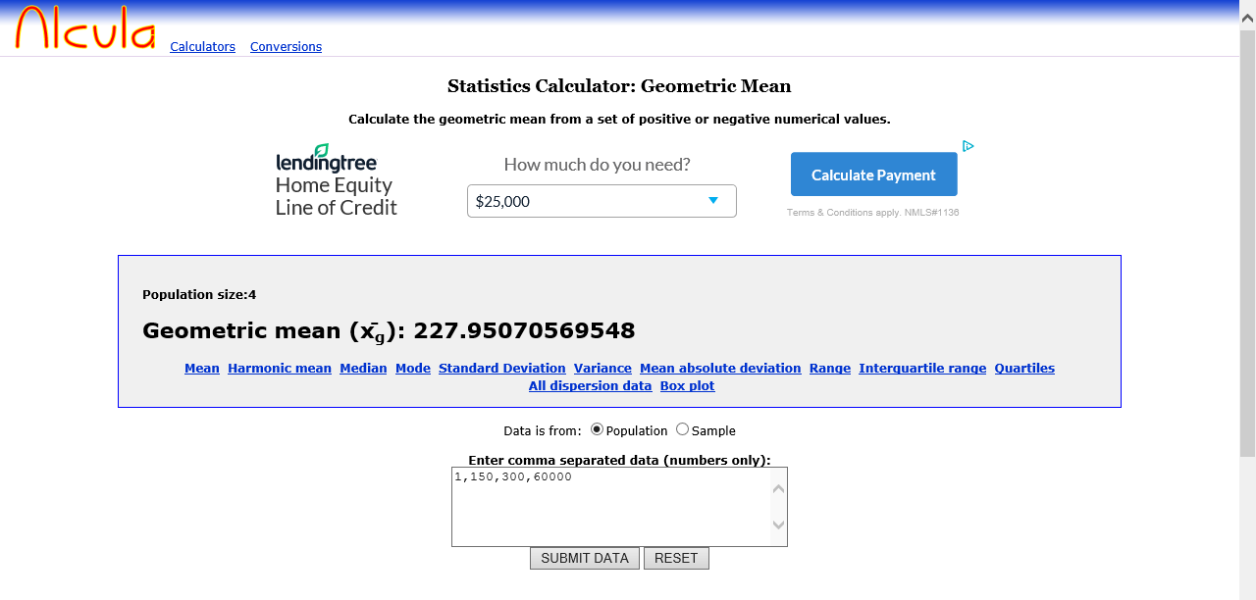
http://www.alcula.com/calculators/statistics/geometric-mean/

Slide 37
Is there a difference between facilities that test 3 times a month compared to 3 times a week?

Slide 38
YES
Why?
Calculations are different. Instead of taking the monthly average, weekly average is used.
How is the weekly average calculated for reporting on DMRs?
A weekly average is calculated by the sum of all daily discharges (concentrations or loads) measured during a calendar week (Sunday – Saturday) divided by the number of daily discharges measured during that week. Unless otherwise specified in the permit, report the maximum weekly average value on DMRs. Example for weekly average
Week 1: (Sample 1 + Sample 2 + Sample 3)/3 = average week 1
Week 2: (Sample 1 + Sample 2 + Sample 3)/3 = average week 2
Week 3: (Sample 1 + Sample 2 + Sample 3)/3 = average week 3
Week 4: (Sample 1 + Sample 2 + Sample 3)/3 = average week 4
Monthly Weekly Average = (Avg. week 1 + Avg. week 2 + Avg. week 3 + Avg. week 4) / 4
Maximum Weekly Average = the highest of the 4 average weeks

Slide 39
Example 1 for facilities that test 2 per month
BOD sample Result Flow of the day of the sample in MGD
1 BPQL 0.36
2 45 0.57
BOD’s BPQL is 2.0 mg/l Monthly Average: (<2.0 + 45)/2= <23.5 Maximum: 45
BOD Loading Calculations: Sample 1: 2.0 X 8.34 X 0.36= <6.0 Sample 2: 45 X 8.34 X 0.57= 213.92
BOD Monthly Loading Average : (<6.0 + 213.92)/2= <109.96
What it should look like on the eDMR:
Loading (Limit is 45) Monthly Average (Limit is 30) Maximum (Limit is 45) No. Ex
BOD <110.0 <23.5 45 0

Slide 40
Example 2
BOD sample Result Flow of the day of the sample in MGD
1 BPQL 0.36
2 65 0.57
BOD’s BPQL is 2.0 mg/l Monthly Average: (<2.0 + 65)/2= <33.5 Maximum: 65
BOD Loading Calculations: Sample 1: <2.0 X 8.34 X 0.36= <6.0 Sample 2: 65 X 8.34 X 0.57= 308.99
BOD Monthly Loading Average : (<6.0 + 308.99)/2= <157.49
What it should look like on the eDMR
Loading (Limit is 45) Monthly Average (Limit is 30) Maximum (Limit is 45) No. Ex
BOD <157.5 <33.5 65 1

Slide 41
Example 3 for facilities that test 3 per month
BOD sample Result Flow of the day of the sample in MGD
1 BPQL 0.36
2 34 0.57
3 Invalid 0.53
BOD’s BPQL is 2.0 mg/l Monthly Average: (<2.0 + 34)/2= <18 Maximum: 34
BOD Loading Calculations: Sample 1: <2.0 X 8.34 X 0.36= <6.0 Sample 2: 34 X 8.34 X 0.57= 161.63
BOD Monthly Loading Average : (<6.0 + 161.63)/2= <83.81
What it should look like on the eDMR
Loading (Limit is 45) Monthly Average (Limit is 30) Maximum (Limit is 45) No. Ex
BOD <83.8 <18 34 1
Is this right? Answer is NO. The maximum was 34 and the limit is 45

Slide 42
Example 3 for facilities that test 3 per Week
BOD sample Result Flow of the day of the sample in MGD
Week 1 1 BPQL 1.1
2 15 0.93
3 Invalid 0.98
Week 2 1 23 1.3
2 54 1.5
3 65 1.5
Week 3 1 35 1.1
2 30 1.1
3 34 0.99
Week 4 1 29 0.95
2 25 0.96
3 22 0.99

Slide 43
Example 3 continued
BOD Concentrations Calculations
BOD’s BPQL is 2.0 mg/l
Week 1: (<2.0 +15)/ 2 = <8.5
Week 2: (23+54+65)/3 = 47.3
Week 3: (35+30+34)/3 = 33
Week 4: (29+25+22)/3 = 25.3
Monthly Weekly Average: (<8.5+47.3+33+25.3)/4 =28.5
Maximum Weekly Average: 47.3

Slide 44
Example 3 continued
BOD Loading Calculations
Week 1: <2.0 x 8.34 x 1.1= <18.3 Week 2: 23 x 8.34 x 1.3 = 249.4
Week 1: 15 x 8.34 x 0.93= 116.3 Week 2: 54 x 8.34 x 1.5 = 675.5
Week 2: 65 x 8.34 x 1.5 = 813.2
Week 3: 35 x 8.34 x 1.1 = 321.1 Week 4: 29 x 8.34 x 0.95 =229.8
Week 3: 30 x 8.34 x 1.1 = 275.2 Week 4: 25 x 8.34 x 0.96 =200.2
Week 3: 34 x 8.34 x 0.99 = 280.7 Week 4: 22 x 8.34 x 0.99 = 181.6

Slide 45
Example 3 continued
Week 1= (18.3 + 116.3)/2 = 269.2
Week 2= (249.4 + 675.5 + 813.2)/3 = 579.4
Week 3= (321.1 + 275.2 + 280.7)/3 = 292.3
Week 4= (229.8 +200.2 +181.6)/3 = 203.9
BOD Loading = (269.2 + 579.4 + 292.3 + 203.9)/4 = <336.2
BOD Monthly Weekly Average = <28.5
BOD Maximum Weekly Average = 47.3

Slide 46
Example 3 continued
What it should look like on the eDMR
Loading (775.6) Mon.WK AVG (30) Maximum (45) No. Ex
BOD <336.2 <28.5 47.3 1

Slide 47
Question 1
BOD sample Result Flow of the day of the sample in MGD
1 BPQL 1.8
2 2 1.1
BOD’s BPQL is 2.0 mg/l Monthly Average: Maximum:
BOD Loading Calculations:
BOD Monthly Average :
What it should look like on the eDMR
Loading Monthly Average Maximum No. Ex
BOD

Slide 48
Answer
BOD’s BPQL is 2.0 mg/l
BOD Loading Calculations: [(<2.0 X 8.34 X 1.8) + (10 X 8.34 X 1.1) ] / 2 = 60.87
BOD Monthly Average : (<2.0 + 10) / 2= <6.0
What it should look like on the eDMR
Loading(225) Monthly Average(30) Maximum(45) No. Ex
BOD 60.9 <6.0 10 0

Slide 49
Question 2
BOD sample Result Flow of the day of the sample in MGD
1 32 1.8
2 14 1.1
3 25 1.2
BOD’s BPQL is 2.0 mg/l Monthly Average: Maximum:
BOD Loading Calculations:
BOD Monthly Average :
What it should look like on the eDMR
Loading Monthly Average Maximum No. Ex
BOD

Slide 50
Question 3
BOD sample Result Flow of the day of the sample in MGD
1 62.3 0.78
2 Invalid test 0.56
BOD’s BPQL is 2.0 mg/l Monthly Average: Maximum:
BOD Loading Calculations:
BOD Monthly Average :
What it should look like on the eDMR
Loading Monthly Average Maximum
BOD

Slide 51
Question 4
Permit requirements:
BOD and TSS 3 per week
pH, total residual chlorine, flow, and dissolved oxygen 5 times per week
Fecal coliform 2 times per week
What are the calculations for this Permit for the month?

Slide 52
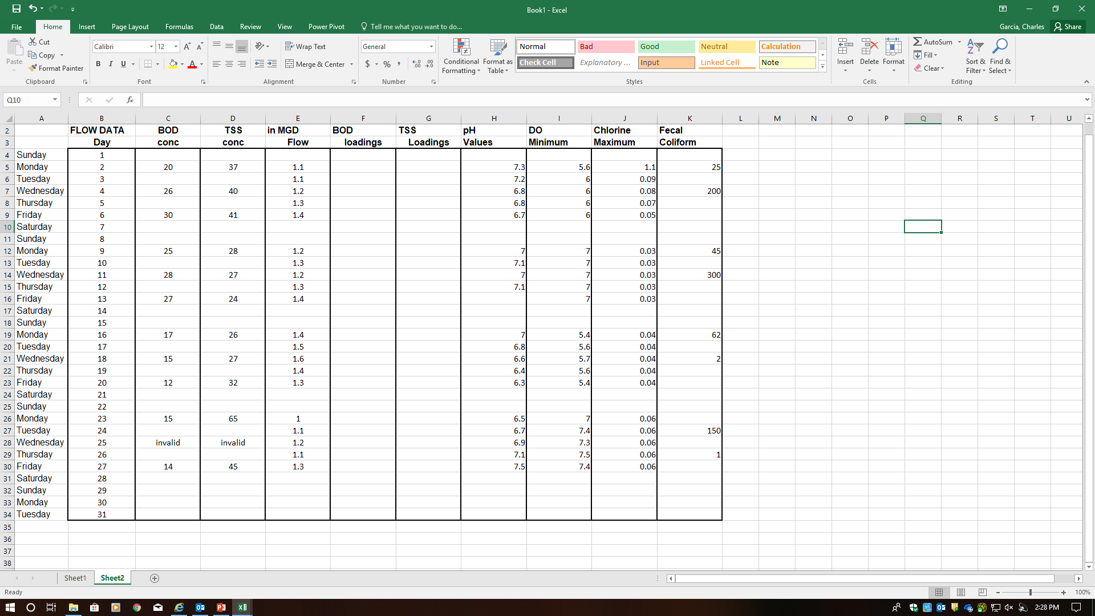

Slide 53
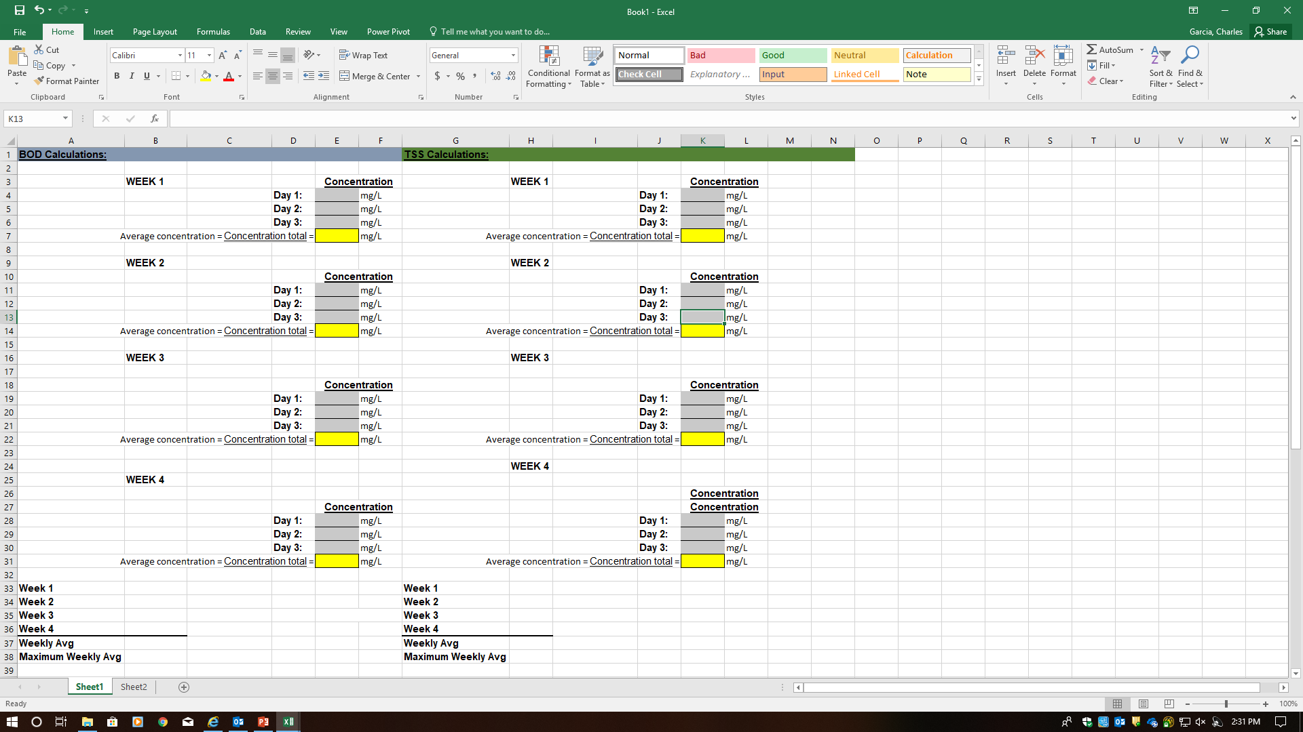

Slide 54
