Slide 1
E2 Signatory
How to Add a Preparer to your Facility.

Slide 2
E2 Signatory Information:
To create an E2 Signatory account, you must go to DEQ CROMERR account registration system and follow the screen instructions to complete the registration.
Each Signatory will manage the preparers attached to his/her facility(s). DEQ will not be involved.
Each Signatory could link any existing E2 Preparer account to his/her facility.
If the Signatory is unable to find the Preparer in the E2 system, they will instruct the them to go to the following web address to set up a Preparer Account:
  Https://applications.deq.ok.gov/e2

Slide 3
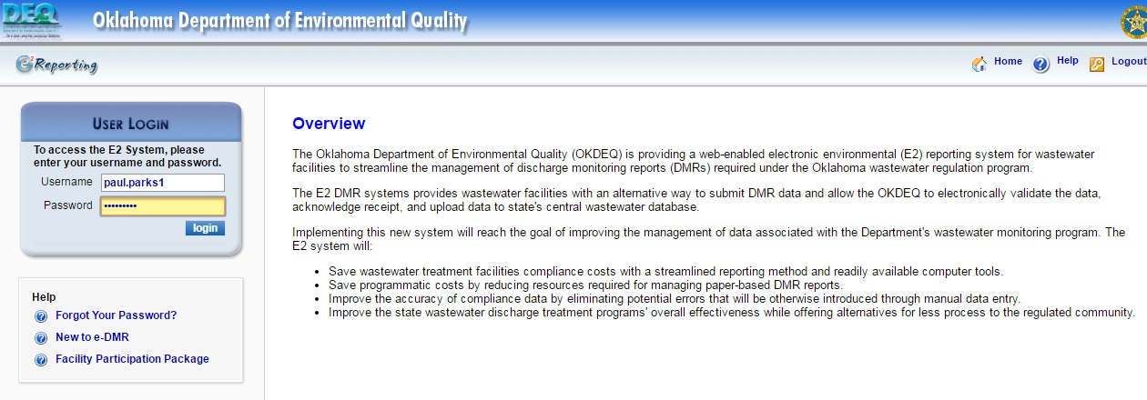
E2: Login Page (Web Address: https://applications.deq.ok.gov/e2)
Adding a Preparer to a Facility
Login for E2

Slide 4
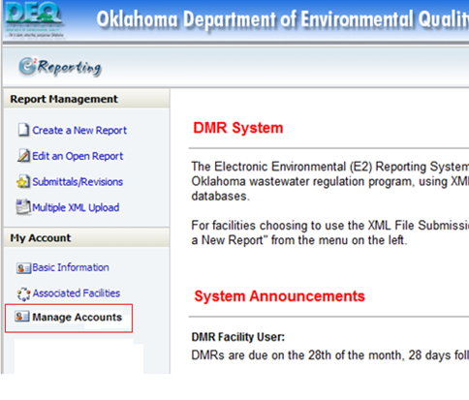
E2: Home Page (After Login)
Adding a Preparer to a Facility
Click Here to add a Preparer to your account.

Slide 5
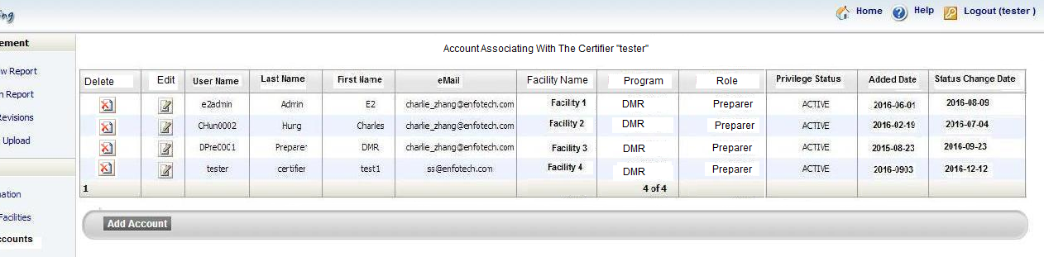
E2: Signatory with Preparer
Adding a Preparer to a Facility
List of Preparers who have been linked to this Signatory
If the Preparer is not listed, clicking here will let the Signatory add them to the list.

Slide 6
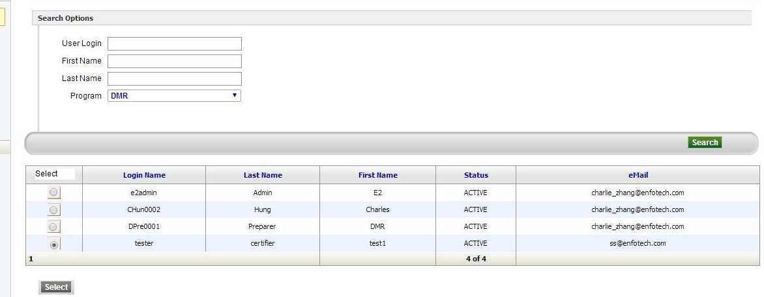
E2: Adding a Preparer Account to a Signatory
Adding a Preparer to a Facility
Enter Preparer’s information into these fields.
Click here to search for the them

Slide 7
E2: Adding a Preparer Account to a Signatory
Adding a Preparer to a Facility
This is the list of Preparers found after you preformed the search.
Use the bubbles to select the Preparer you want to add.
After you have selected the Preparer, click here.
Can’t find the Preparer? Notify the person who will act as a Preparer to go to E2 and create a Preparer Account.

Slide 8
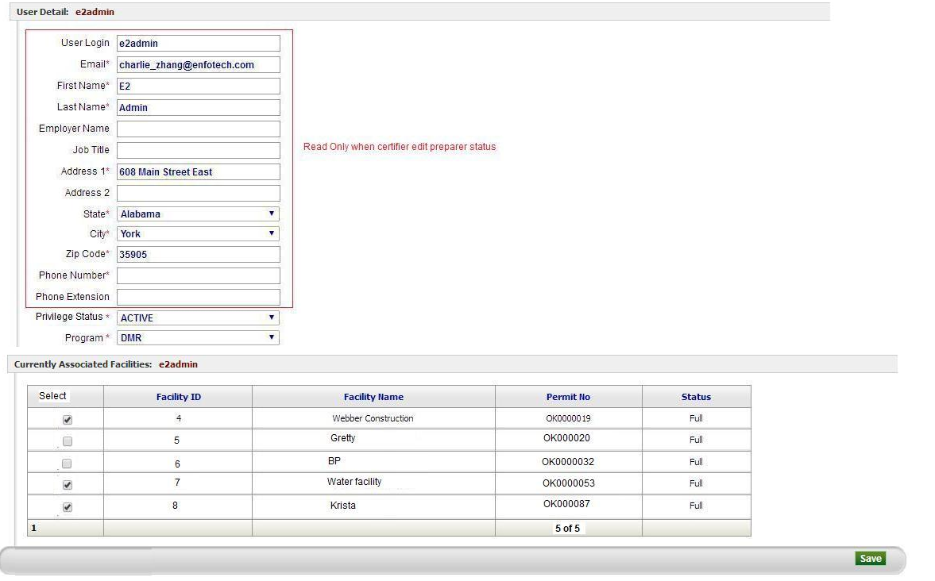
E2: After the Preparer is selected
Adding a Preparer to a Facility
This information is Read Only, a Signatory cannot change anything in these fields. Only the Preparer can.

Slide 9
E2: After the Preparer is selected
Adding a Preparer to a Facility
Active: approving the Preparer to access the Signatory’s Account.
Inactive: disapproving the Preparer to access the Signatory’s Account.
Signatory’s can use this drop down to change a Preparer from Inactive to Active, or visa versa. (Set to Inactive by Default)
List of all facilities approved by DEQ for this Signatory will be listed here.
Check the facilities that the Preparer will be granted data access privilege.
After you have completed everything, click here.

