Slide 1
Good Afternoon!
Please make sure you are Muted and Videos Are Turned Off.`

Slide 2
SCHEDULE
Introductions
Tier II 101 – PowerPoint
Introduction to Tier II Submit 2024
Example – Working Tier II Submit 2024
DEQ Website and Online Filing System

Slide 3
2024 TIER II Reporting at DEQ

Slide 4
What is Tier II Reporting
Database of facilities in Oklahoma that store over a reporting threshold of hazardous materials in the state.
Over 50,000 reports annually
Covers facilities from Tank Batteries to Chemical Facilities to Water Treatment Plants
Reports are submitted between January 1 and March 1 of every year.

Slide 5
What is Tier II Reporting (pt2)
Reports are filed to the DEQ
DEQ then disperses Tier II Data to the County LEPC. County then disperses the data to the First Responder in that area
Public may request a copy of a Tier II Report by submitting a request for data to the DEQ

Slide 6
What Requires You to File a Tier II Report
ANY Chemical that is defined as Hazardous by OSHA Regulations
Over Threshold stored on site
  10,000lbs for non EHS (~34 barrels of Oil)
  EHS chemicals are lower TPQ (found on the EPA List of Lists)
24 Hour Period

Slide 7
What Do You Need to File
Tier II Submit 2024 Software – out now
Login/Password
Last Years Report
Gallons to Pounds Converter (if needed)
Helpful Attachments (Optional)

Slide 8
What has changed for 2024
Enhanced the Contact record interface so that the initial data fields display dynamically based on the chosen Contact Type(s).
Updated state-specific fields for reporting year 2024.
Added flexibility to the Maximum Number of Occupants field when the facility is marked as Unmanned to allow states, tribes, and territories to collect additional data if preferred in their areas.

Slide 9
What has changed for 2024
Modified behavior to allow Tier2 Submit 2024 to be run side-by-side with an older Tier2 Submit 2023 (or 2022) version.
DEQ Online Portal Payment

Slide 10
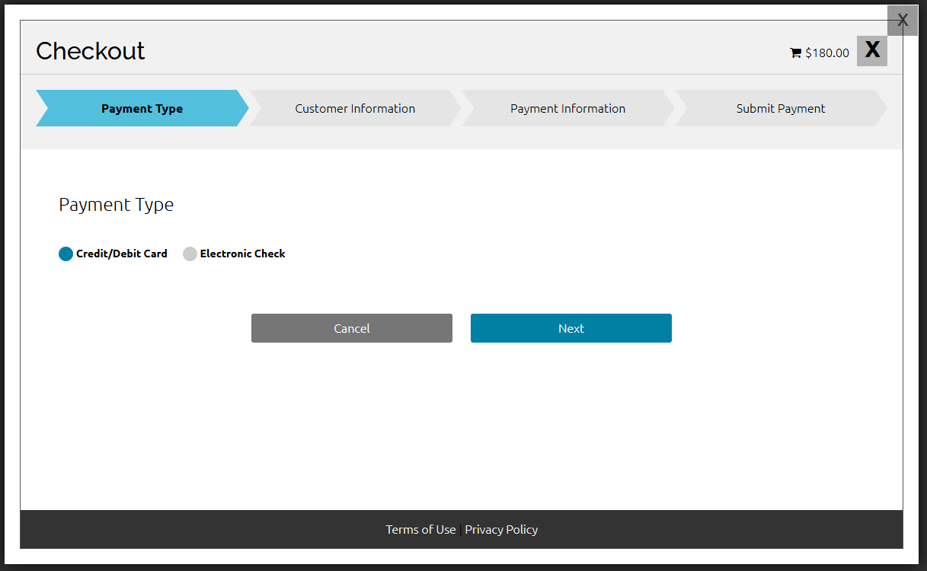
New DEQ Online Payment Portal

Slide 11
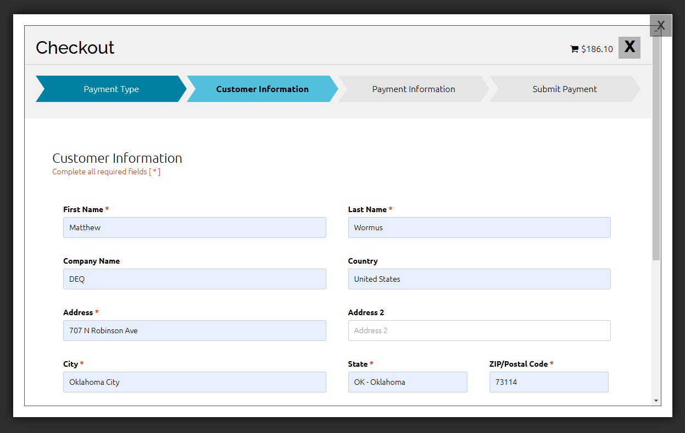
Payment via Credit Card

Slide 12
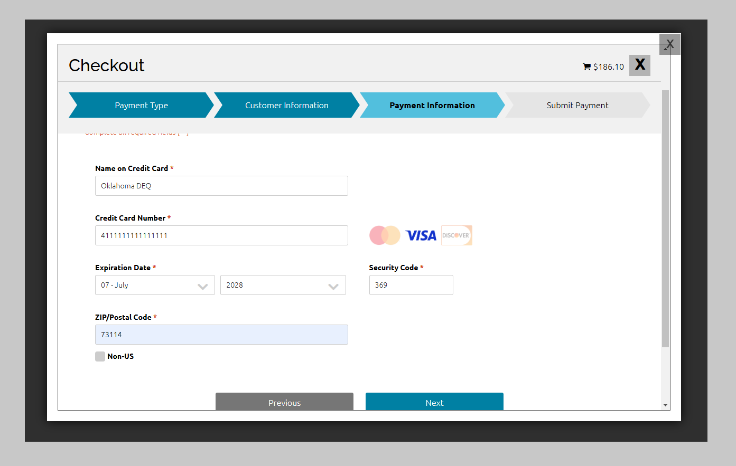
Payment via Credit Card

Slide 13
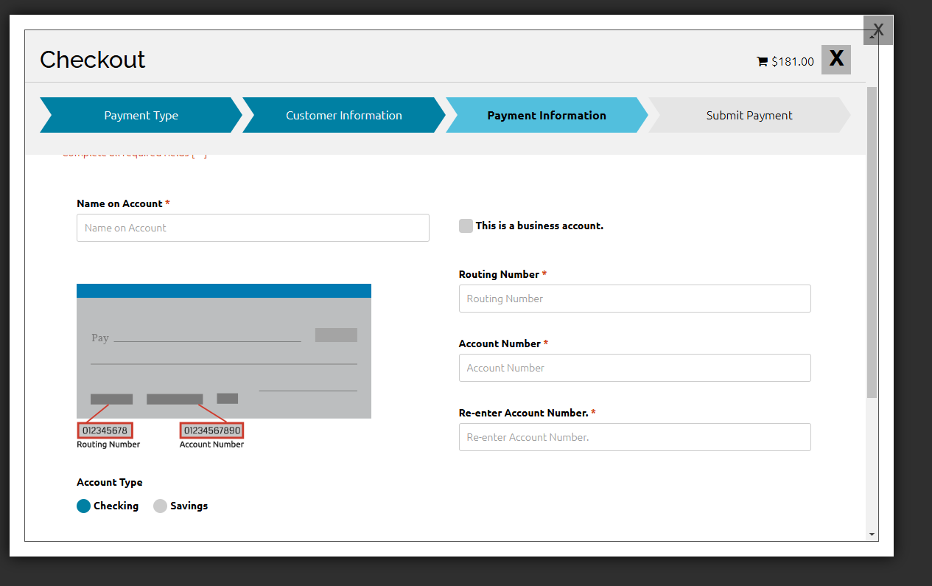
Payment Routing Number

Slide 14
How to Get Tier II Assistance
Call/Email at anytime
  ask for Tier II Help
Online Tier II Training
  December 12th
IF in OKC Area, make appointment to meet at the DEQ Offices in OKC
  NOTE – Ongoing Construction may limit days to meet.
IF NOT in OKC, help sessions will be held around the state
  Survey in chat. Will close on 12/14

Slide 15
Billing Advice – From DEQ Finance
When requesting corrections to an order to place the order number in the Subject line of the email.
  ARHelpdesk@deq.ok.gov
  405-702-1130
One invoice PER account.
Do not email Credit Card info. Only call the number or mail it in

Slide 16
Report is filed, now what?
Pay your invoice by April 1st
Check Tier II GIS Map to see if report has been received
Be active in your LEPC
  Especially EHS sites
Keep report “living”
  Email or call with ANY changes to contacts, chemicals stored, etc.

Slide 17
Matt Wormus
  Matthew.wormus@deq.ok.gov
  405-702-5137
Tommy Holbrook
  Tommy.Holbrook@deq.ok.gov
  405-702-5156

